Slide 1

Rationale
Introduction to Windows Store App Development Using HTML5 and JavaScript
Computer science is a field of study that deals with solving a variety of problems by using computers.
  To solve a given problem by using computers, you need to design an algorithm for it.
Multiple algorithms can be designed to solve a particular problem.
An algorithm that provides the maximum efficiency should be used for solving the problem.
  The efficiency of an algorithm can be improved by using an appropriate data structure.
Data structures help in creating programs that are simple, reusable, and easy to maintain.
This module will enable a learner to select and implement an appropriate data structure and algorithm to solve a given programming problem.

Slide 2
Objectives
  In this session, you will learn to:
  Implement toast notification
Notes:
2

Slide 3

Responding to a Toast Notification
  When the user clicks a toast notification:
  The corresponding app is launched with the content displayed in the notification.
  The view of the launched app depends on the notification displayed.
  While responding to a toast notification:
  Pass the information about the view to be launched as a launch parameter for the app.

Slide 4
Responding to a Toast Notification (Contd.)
  To respond to a toast notification:
Include the data that you want to display in your toast.
Access data at the time of app launch.

Slide 5

Demo: Implementing Toast Notification
  Problem Statement:
  Jake has developed a coin catcher game named Greedy Basket for Windows Store. The game allows a user to collect coins in a basket. The user is assigned one score point for every coin that he/she collects successfully in the basket.

Slide 6
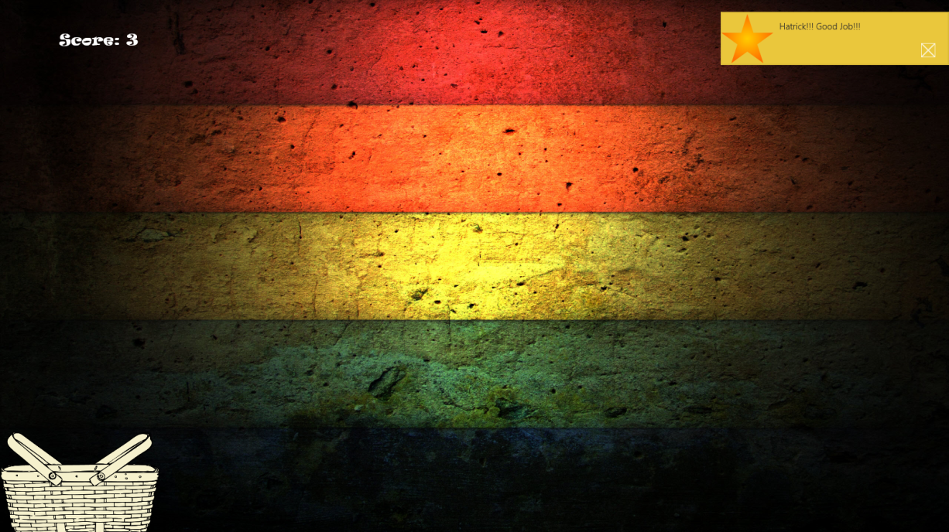
Demo: Implementing Toast Notification (Contd.)
  Now, Jake needs to enhance the app by sending a toast notification that will notify the users whenever a user collects the three coins continuously. The toast notification should be displayed, as shown in the following figure.

Slide 7
Demo: Implementing Toast Notification (Contd.)
  Help Jake in implementing the desired functionalities in the app.

Slide 8
Demo: Implementing Toast Notification (Contd.)
  Solution:
  To implement the required functionality, Jake needs to perform the following tasks:
    1. Enable the toast notification in the package.appxmanifest file.
    2. Add image file in the project.
    3. Add the toast notification.
    4. Execute the app and verify the output.

Slide 9
Summary
  In this session, you learned that:
  To respond to a toast notification, you need to:
    Include the data that you want to display in your toast.
    Access data at the time of app launch.
Notes:
9

Slide 10

Q&A

